Slide 1



Integrated Program in Business Analytics
Adidas US Sales Clustering
Group A – Batch 13

Slide 2
Agenda
Business Problem and Objectives
Executive Summary
Data Overview and Key Business Assumptions (if any)
Data Preparation and Pre-processing
Sanity checks, treatment and transformations for analytical dataset preparation
Exploratory Data Analysis
Key Business Findings and Insights
Model Development and Validations
Model comparisons on key scoring metrics and model finalization
Dashboarding (required only when it is in scope of analysis)
Businesss Recommendations and Potential Business Impact
Next Steps
Appendix

Slide 3

Problem Statement
Segment the retailers based on various attributes such as type of product purchases, profit, total sales, sales method in order to better facilitate and improve the processes wherever necessary
Primary Objectives
Higher Revenue
Customer Understanding
Target Marketing

Slide 4
About the Dataset
Adidas US sales dataset is a collection of data that includes information on the sales of Adidas products. This type of dataset may include details such as the number of units sold, the total sales revenue, the location of the sales, the type of product sold, and any other relevant information. The general invoice timestamps range from 1/1/2020 to 31/12/2021
Assumptions
Include Assumptions if any

Slide 5
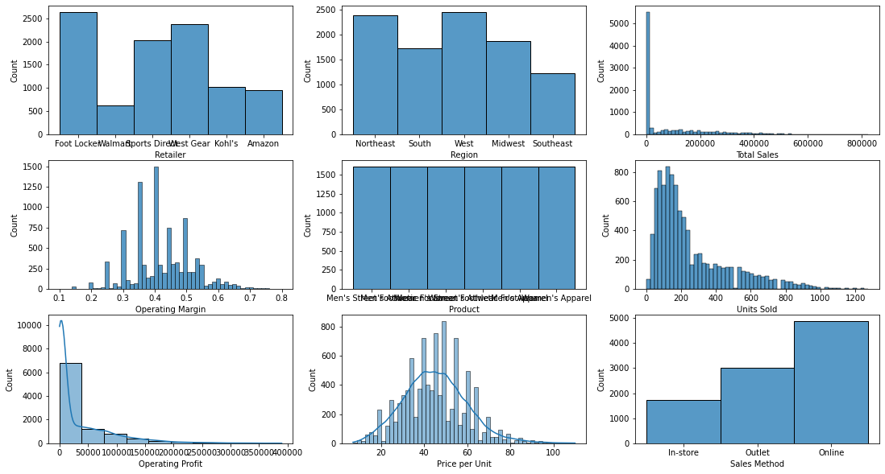
Exploratory Data Analysis
Footlocker is the most frequent occurring retailer in the dataset
Total Sales, Operating profit and Units Sold are interrelated and are right skewed
'Price Per unit' is normally distributed. 'Operating Margin' almost takes the shape of a bell
Online sales are the highest
All products are almost equally distributed
North-east and West contribute to the most observed regions throughout the dataset

Slide 6
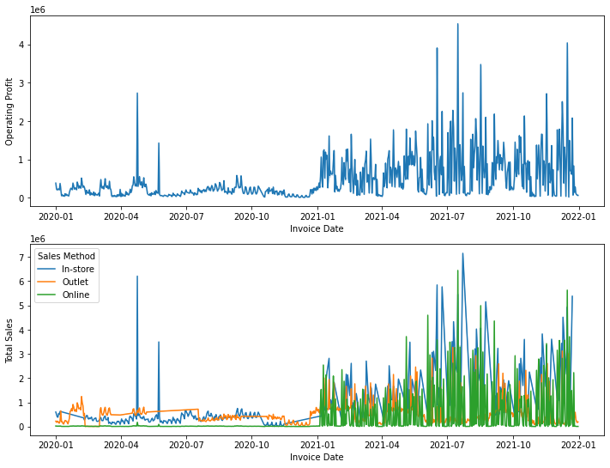
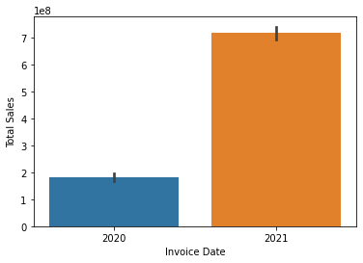
Exploratory Data Analysis (Bi-variate)
Significant improvement in sales as compared to 2020 in 2021
Online sales have surfaced in the year 2021 which can suggest the possible jump in the overall sales

Slide 7
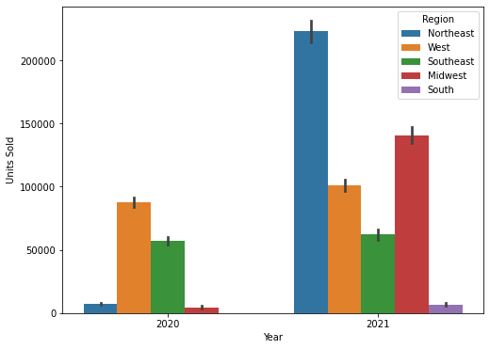
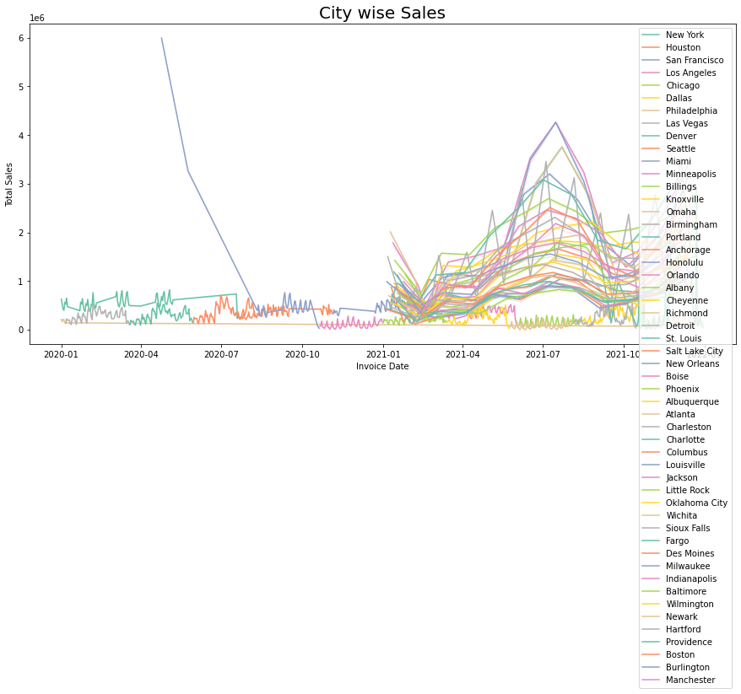
Exploratory Data Analysis (Bi-variate)
Influx of South region in the year 2021
Various other cities have picked up on sales the coming year

Slide 8
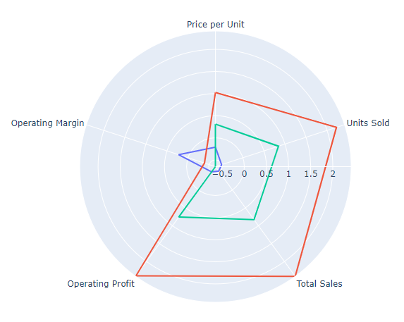
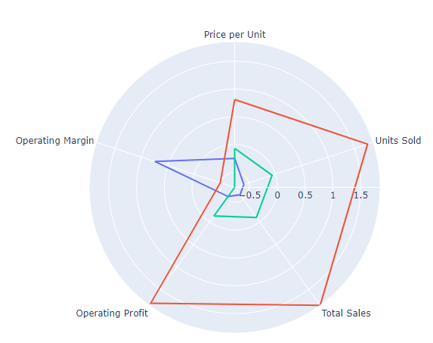
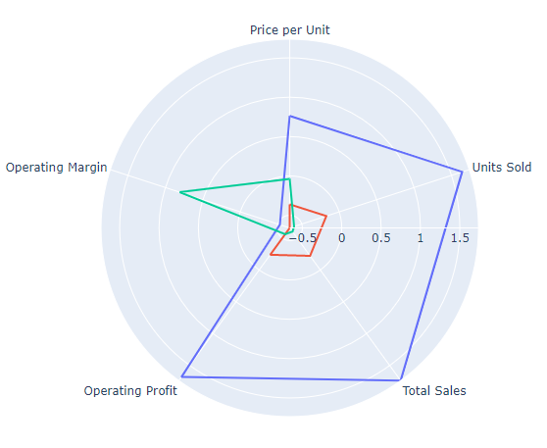
K- Prototype Clustering
Clustering technique Selection
K – means clustering was initially performed as the base level clustering to compare the results based on the mean
Hierarchal and K-prototype clustering was done going forward. However, all three techniques resulted in clusters with similar characteristics
As K-prototype had the ability to cluster categorical features based on the mode, it was chosen to better interpret the clusters
Hierarchal
Clustering
K- means
Clustering

Slide 9
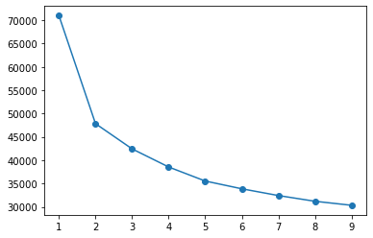
Clustering (K- Prototype Method)
K Prototype which has the ability to cluster categorical features has been selected as it has shown similar clusters when compared to the other clustering methods
3 clusters have been passed as the parameter as per the elbow graph and testing the cluster characteristics with higher numbers
The clusters formed distinctly had the following features
Cluster 1 (blue): Low operating margin but the other features are trending high
Cluster 2 (red): Similar characteristics as cluster 1 but the averages for the features are significantly low
Cluster 3 (green): High operating margin whereas the other features are trending comparatively low

Slide 10
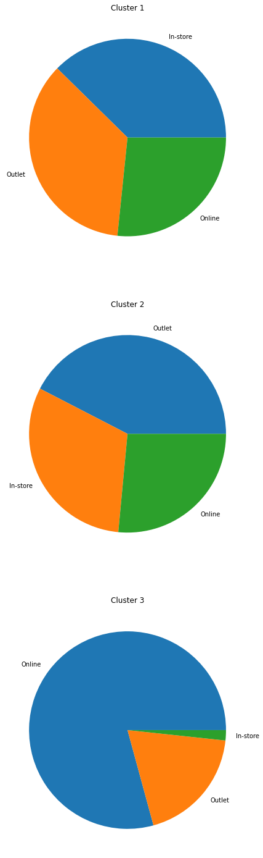
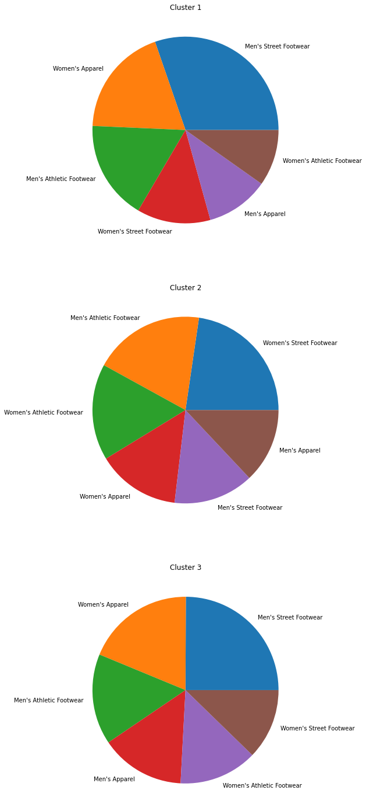
Business Insights in Clusters
Cluster 1 (Low operating margin and high averages of other features)
Sales methods are almost evenly distributed
Women’s apparel is the least occurring item
Cluster 2 (Low operating margin and low averages of other features)
Outlet sales are higher than the in-store sales
Women’s apparel is the least occurring item
Cluster 3 (High operating margin and low averages of other features)
Online sales are significantly higher
Women’s apparel is the most frequently occurring item

Slide 11
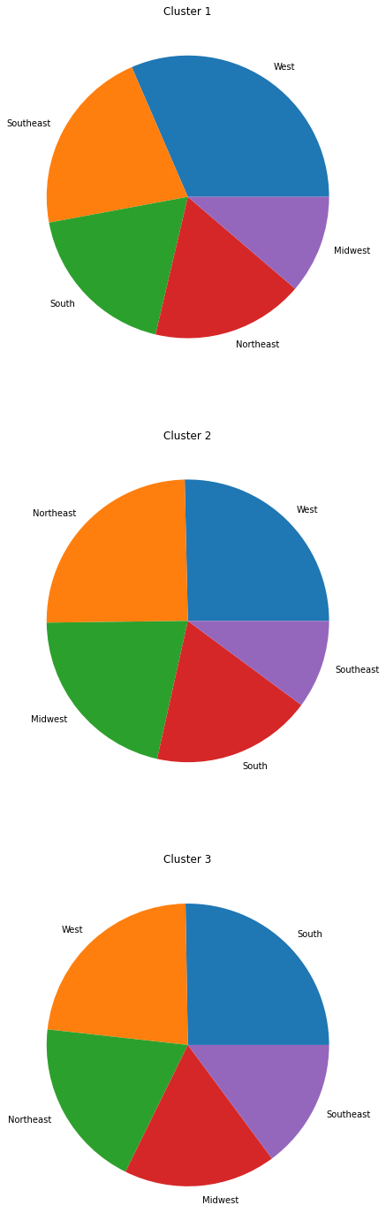
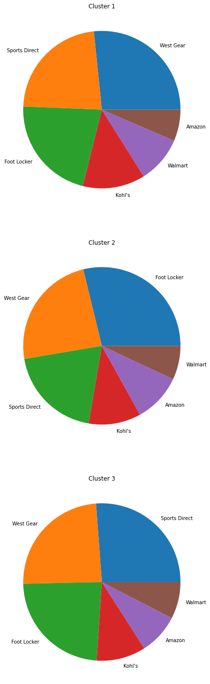
Business Insights in Clusters (Retailer and Region - optional)
Cluster 1 (Low operating margin and high averages of other features)
Cluster 2 (Low operating margin and low averages of other features)
Cluster 3 (High operating margin and low averages of other features)

Slide 12
Business Insights in Clusters (Retailer and Region - optional)
Cluster 1 (Low operating margin and high averages of other features)
Cluster 2 (Low operating margin and low averages of other features)
Cluster 3 (High operating margin and low averages of other features)

Slide 13
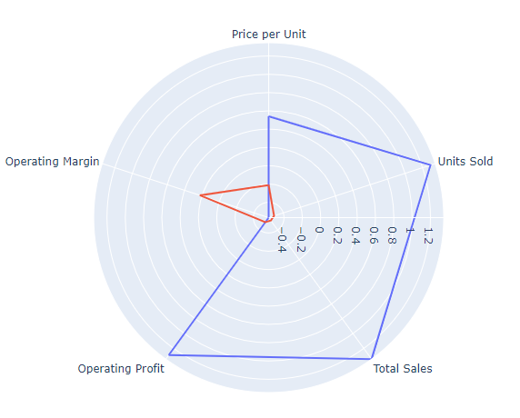
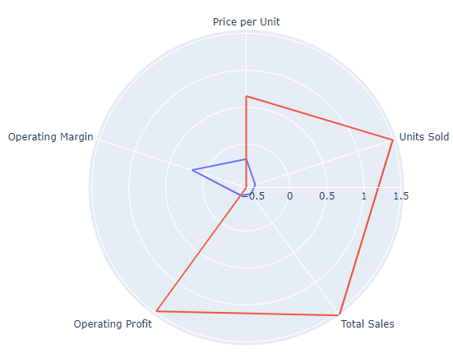
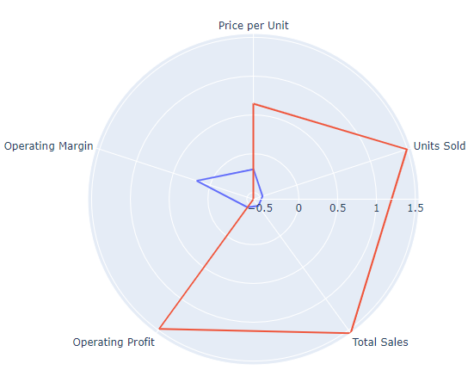
K- Prototype Clustering
Clustering technique Selection
K – means clustering was initially performed as the base level clustering to compare the results based on the mean
Hierarchal and K-prototype clustering was done going forward. However, all three techniques resulted in clusters with similar characteristics
As K-prototype had the ability to cluster categorical features based on the mode, it was chosen to better interpret the clusters
Hierarchal
Clustering
K- means
Clustering

Slide 14
Clustering (Only 2 Clusters)

Slide 15
Clustering (K- means Method)
2 clusters have been passed as the parameter as per the elbow graph and testing the cluster characteristics with higher numbers
The clusters formed distinctly had the following features
Cluster 1 (red): Low operating margin but the other features are trending high
Cluster 2 (blue): High operating margin but other features are performing low

Slide 16
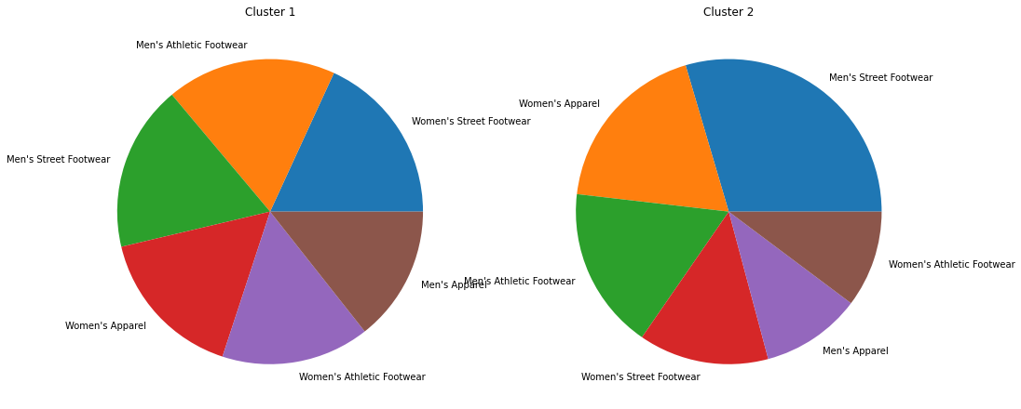
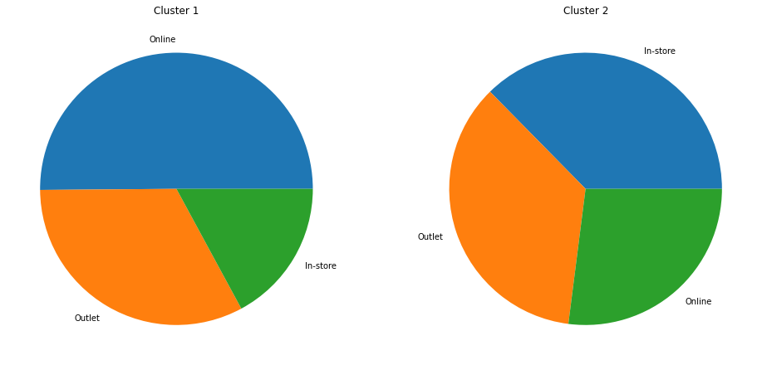
Business Insights in Clusters (Sales method and Product)
Cluster 1 (Low operating margin and high averages of other features)
Highest Online Sales
Cluster 2 (High operating margin and low averages of other features)
Lowest in online sales

Slide 17
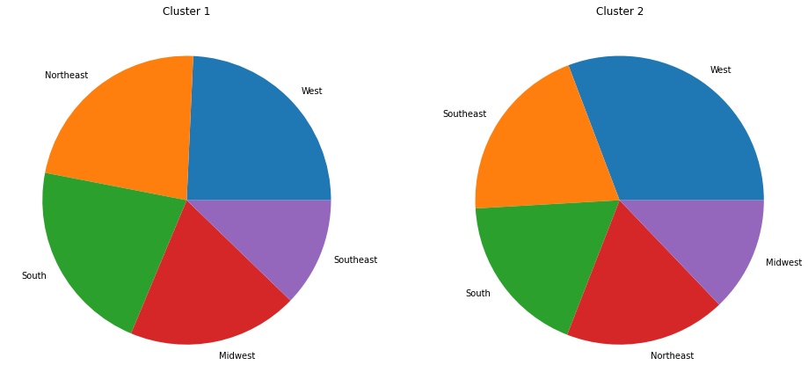
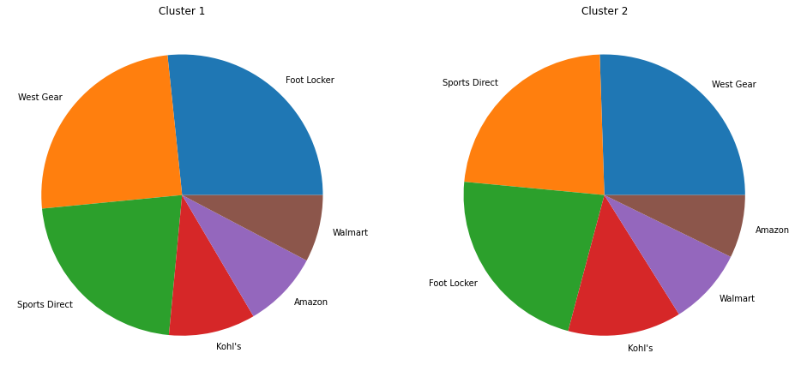
Business Insights in Clusters (Region and Retailer)
Cluster 1 (Low operating margin and high averages of other features)
Highest Online Sales
Cluster 2 (High operating margin and low averages of other features)
Lowest in online sales

Slide 18
Thank You

